Slide 1
EN 204
Material Science for Energy Applications
Class 7
Shaibal K Sarkar
Department of Energy Science and Engineering
shaibal.sarkar@iitb.ac.in

Slide 2
Recap of the Objective
What is n ?
Understanding J = n.q.v
What is v ?
n = f (density of states, statistical distribution)
☞
Density of states = f (band structure)
✓
Band structure = f(periodic potential)

Slide 3
Recap of the last class
One doubt:
The density of states per eV was calculated for a certain metal to be about 10²⁷.
Someone is asked to calculate the number of electrons for this metal. He argues that because of the Pauli principle, two electrons occupy each energy state and hence there are 2X10²⁷ electrons in the band.
k
k
k_{min}
k_{max}
k_{min}
k_{max}

Slide 4
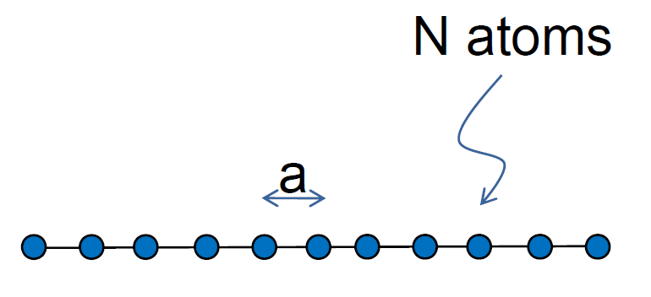
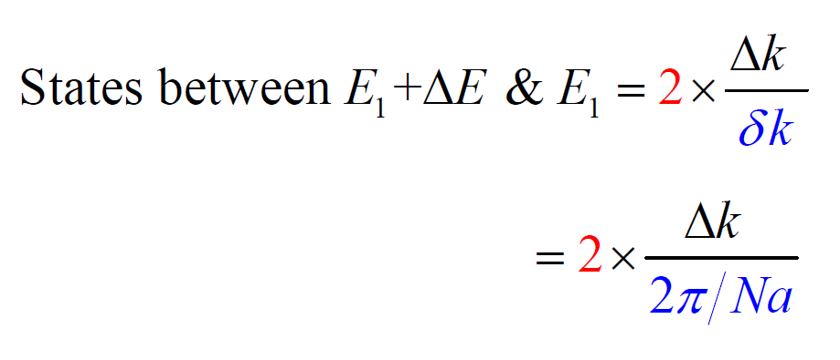
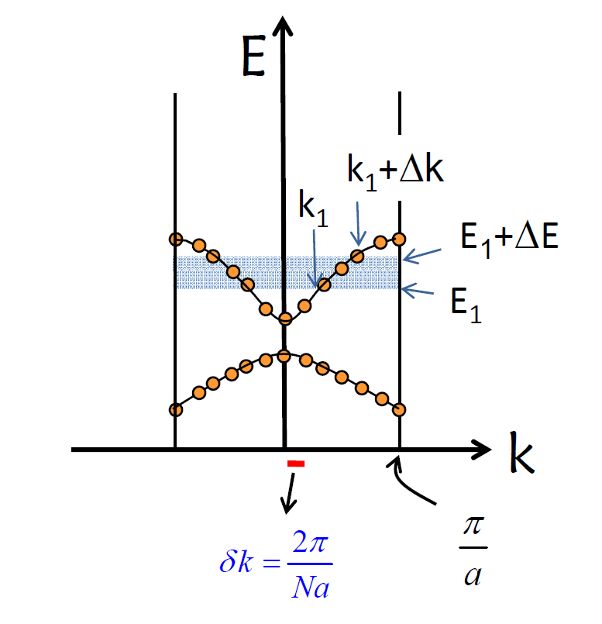
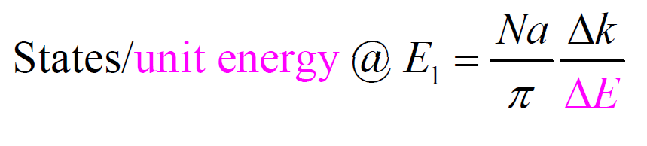
Density of States (DOS) – 1D

Slide 5
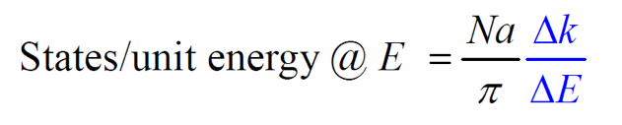
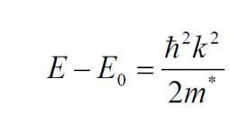
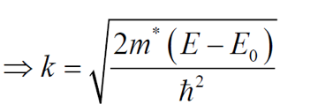
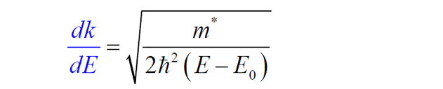
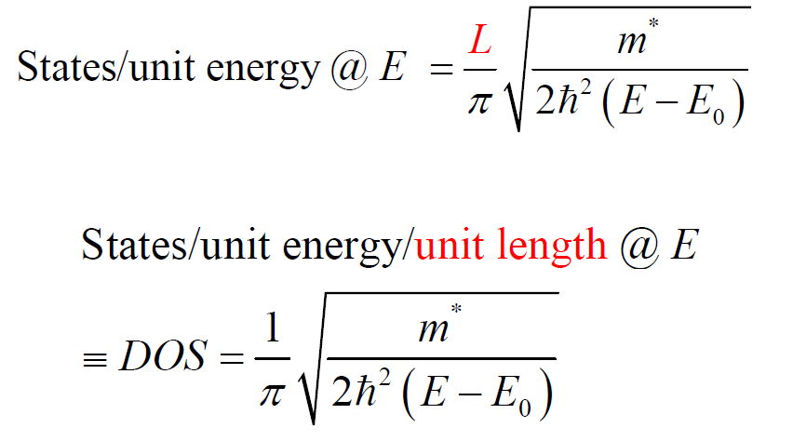
Density of States (DOS) – 1D

Slide 6
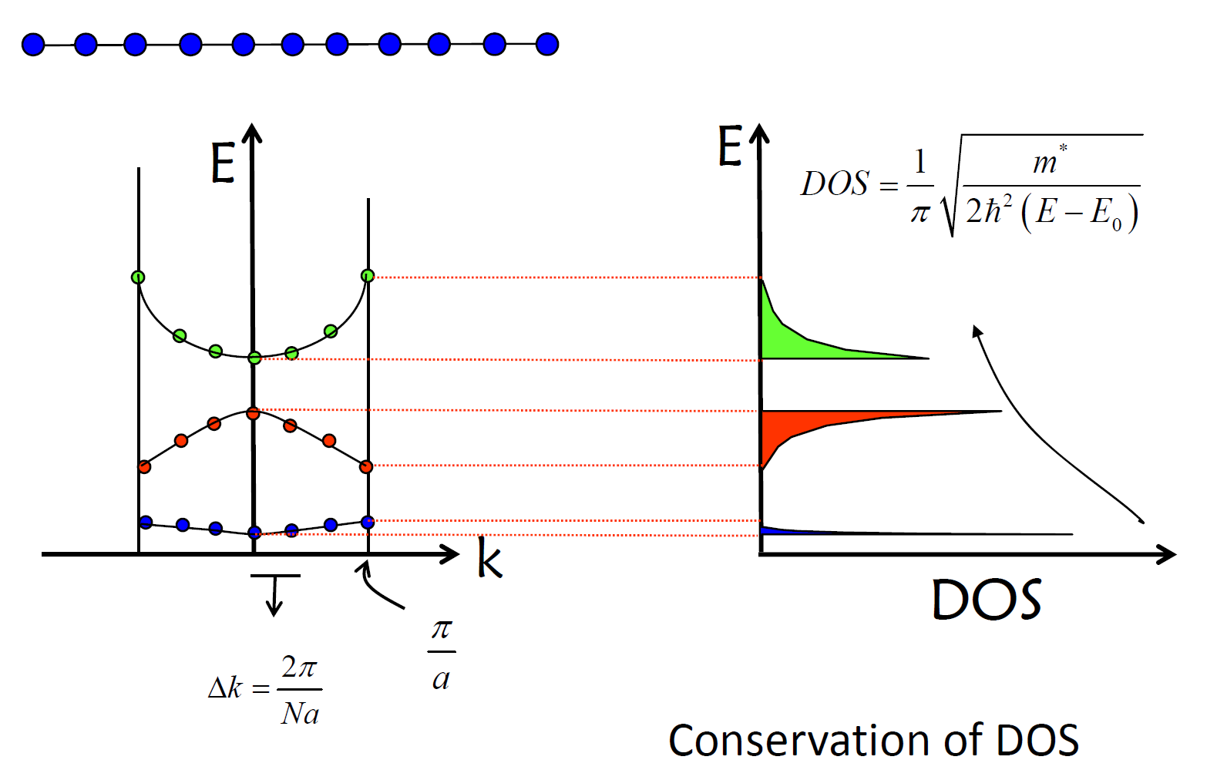
Density of States (DOS) – 1D

Slide 7
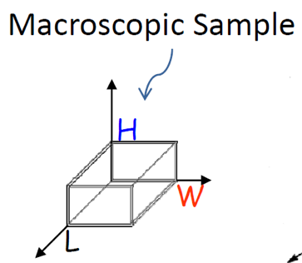
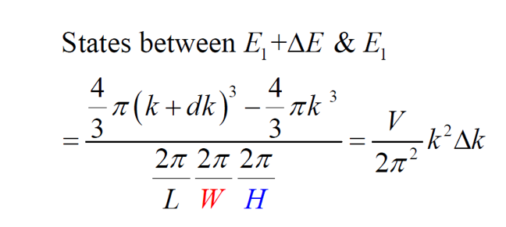
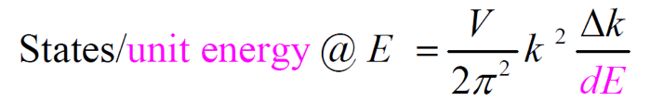
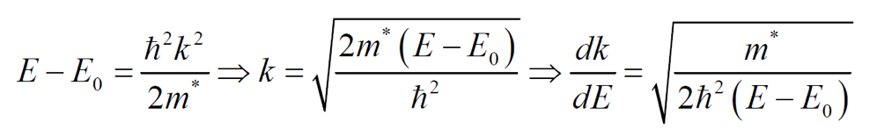
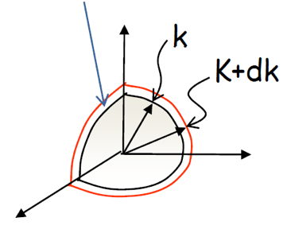
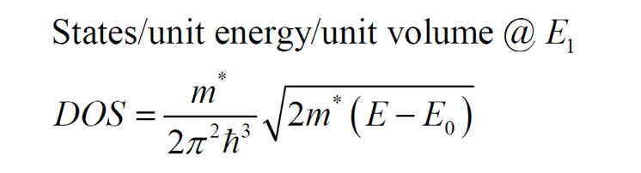
Density of States (DOS) – 3D

Slide 8
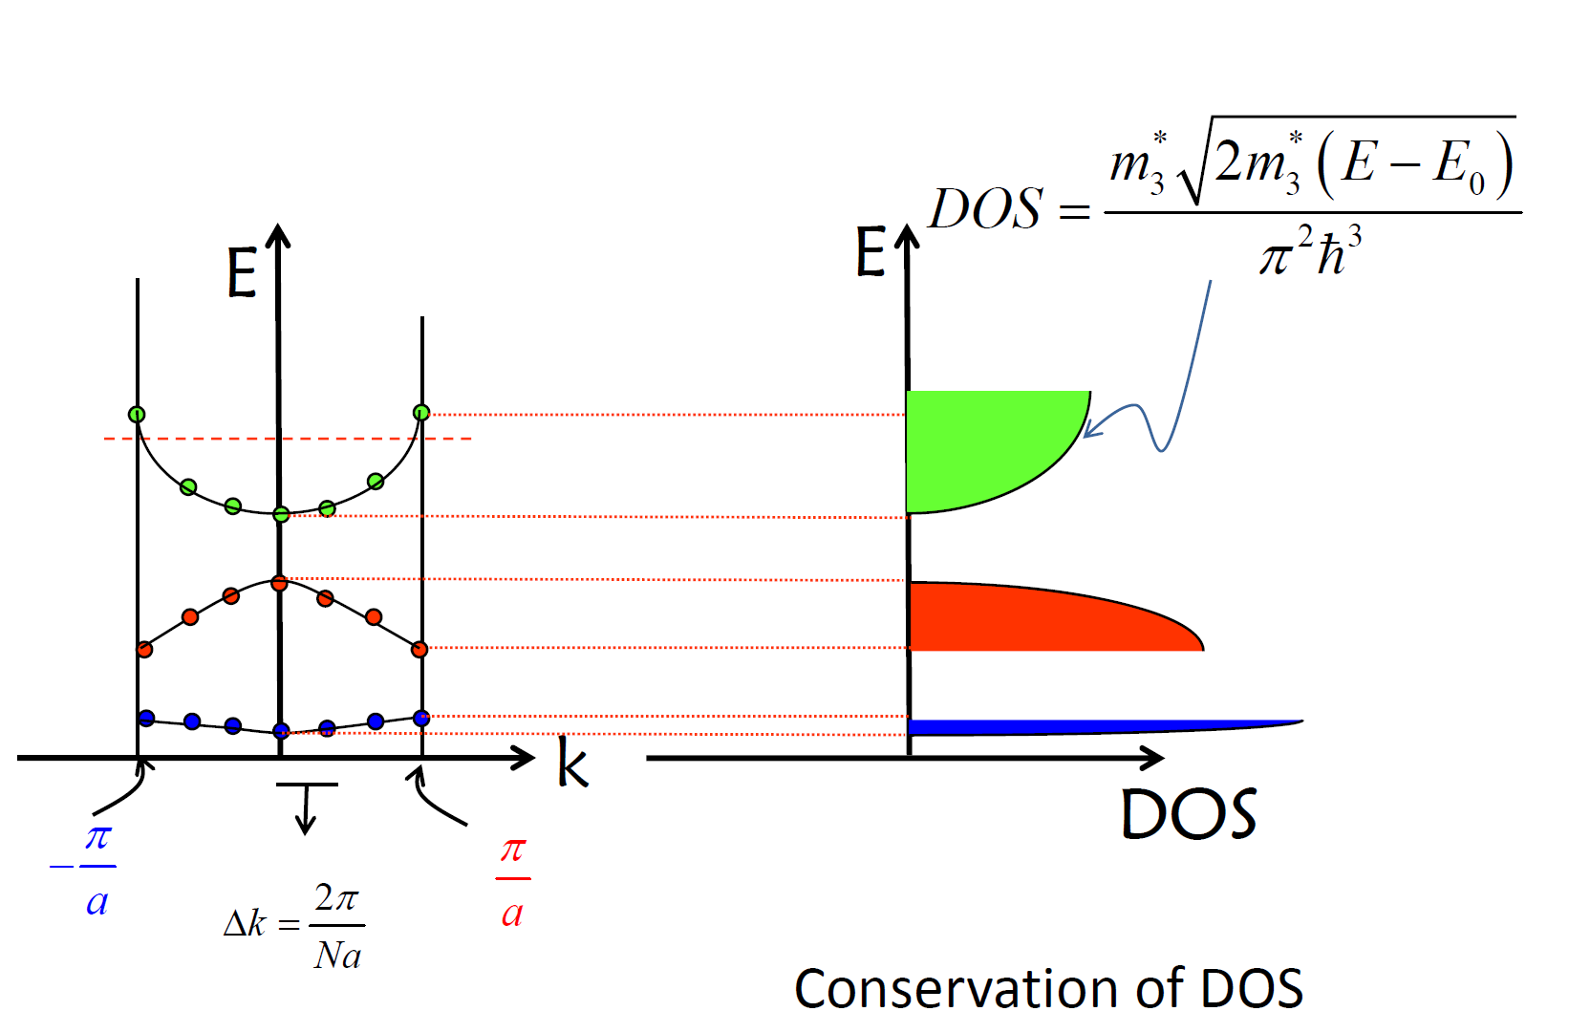
Density of States (DOS) – 3D

Slide 9
Assignment
Determine the Density of States expression for 2D solid, say Graphene

Slide 10
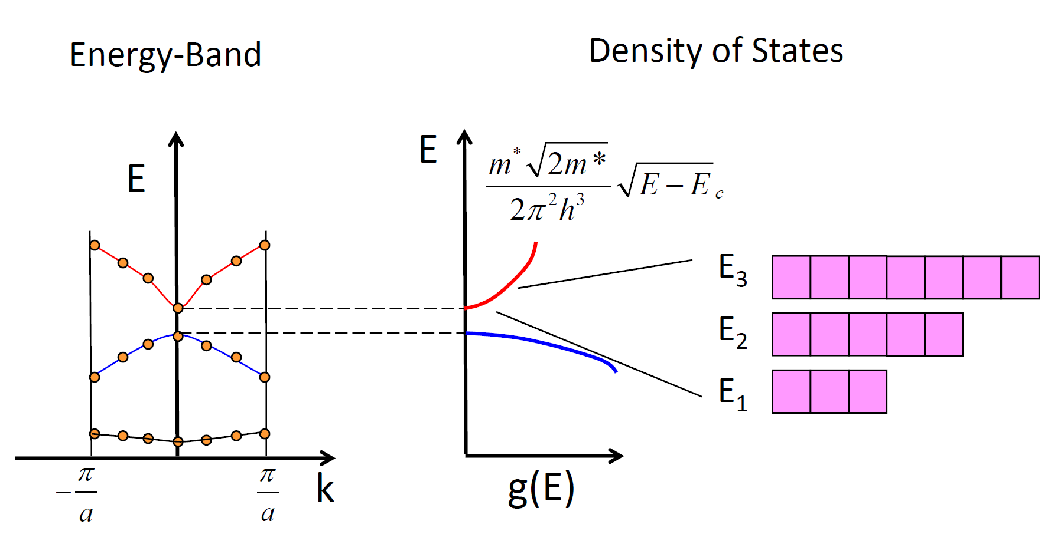
Density of States (DOS) – 3D

Slide 11
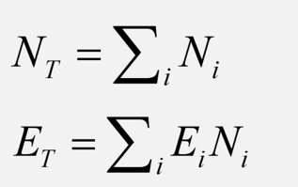
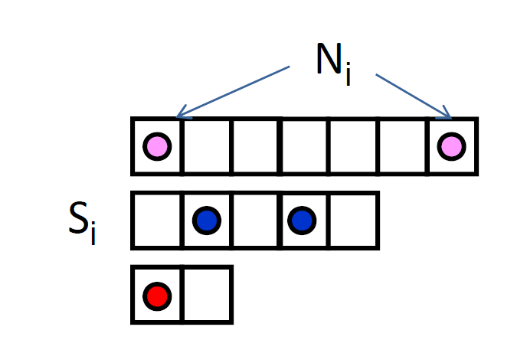
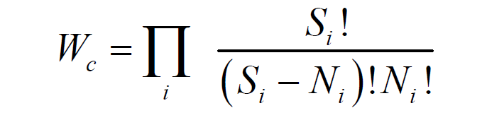
Most Probable Distribution
Pauli’s principle is satisfied
Total Number of Electrons is conserved *
Total Energy of the system is conserved *
* Any discrepancy?
Number of configuration electron can arrange

Slide 12
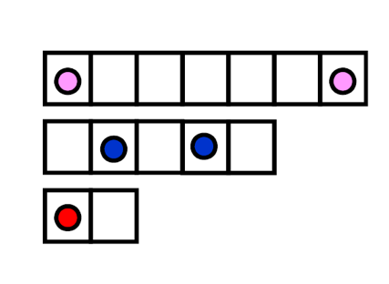
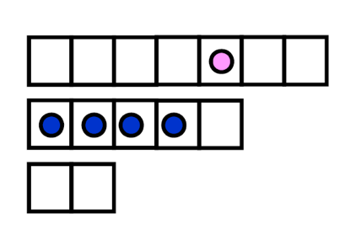
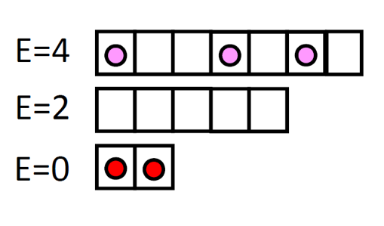
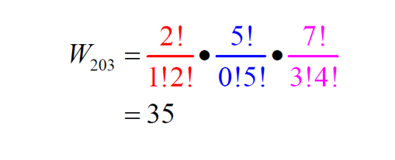
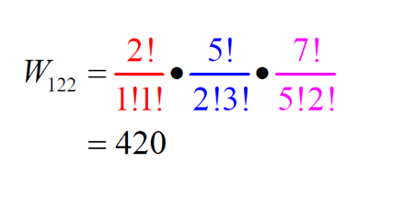
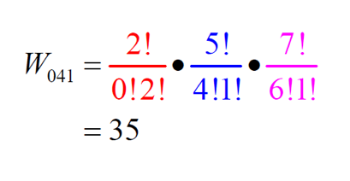
Most Probable Distribution

Slide 13
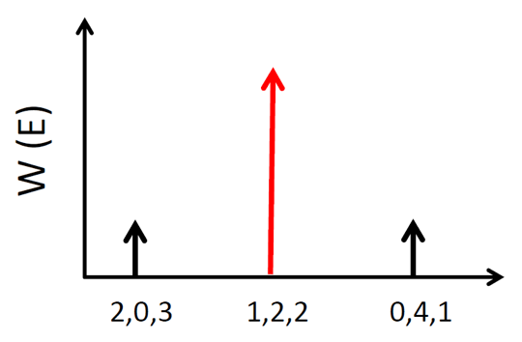
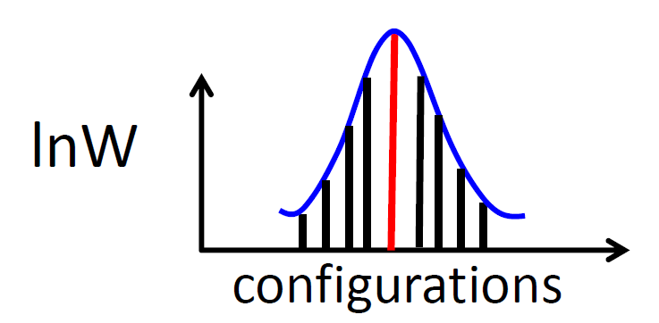
Statistically Most Probable Distribution

Slide 14
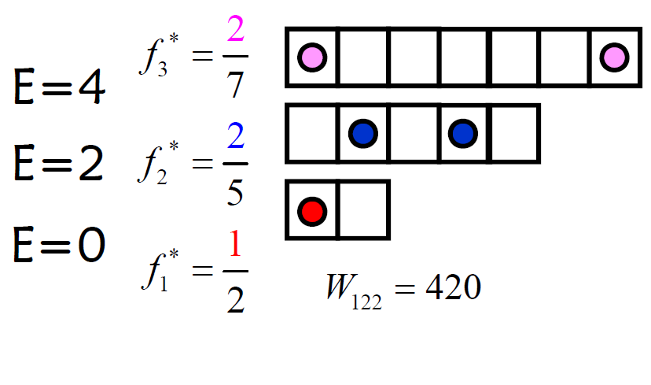
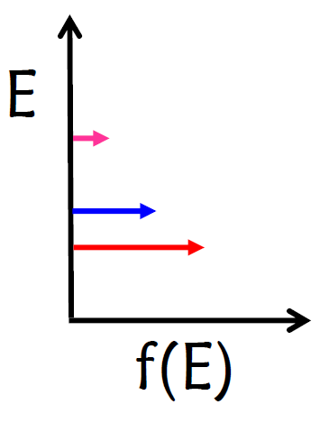
Most Probable Distribution
Fermi distribution of electrons in energy levels
Most probable occupation per energy level
Statistically Most Probable Distribution

Slide 15
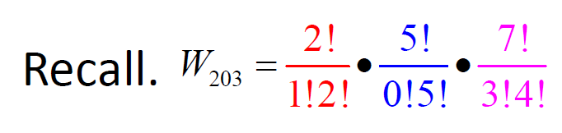
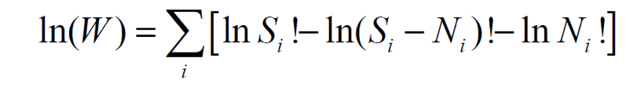
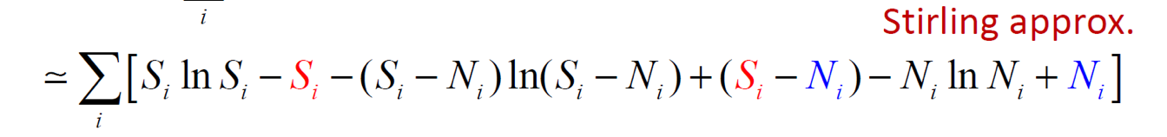
Fermi Statistics: Most Probable Distribution
For “BULK” materials with N number of states,

Slide 16
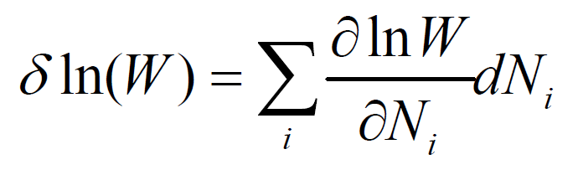
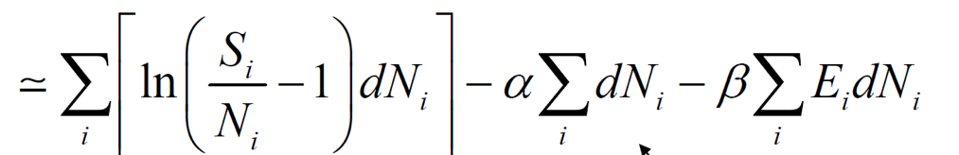
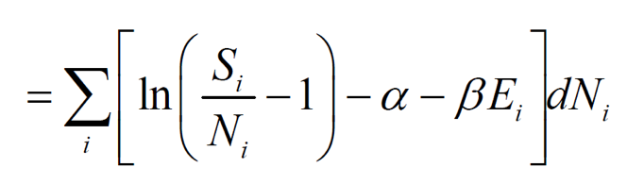
Fermi Statistics: Most Probable Distribution
Optimization with Lagrange Multiplier

Slide 17
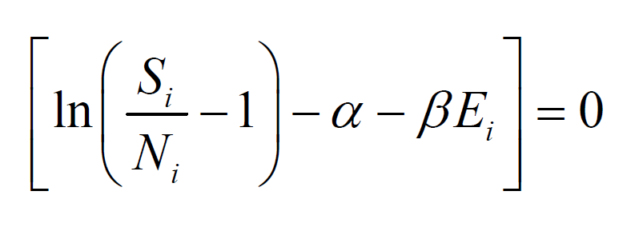
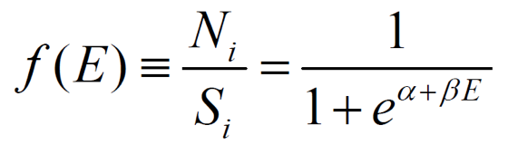
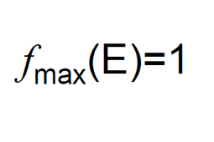
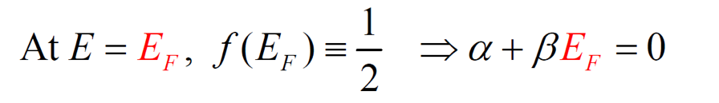
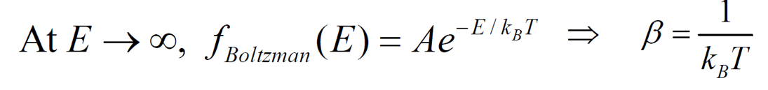
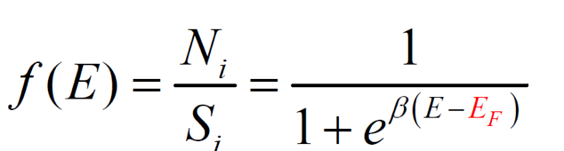
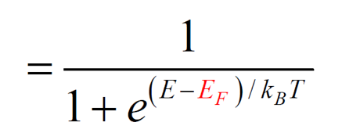
Fermi Statistics: Most Probable Distribution
What is the significance of TEMPERATURE in the f(E) expression?

Slide 18
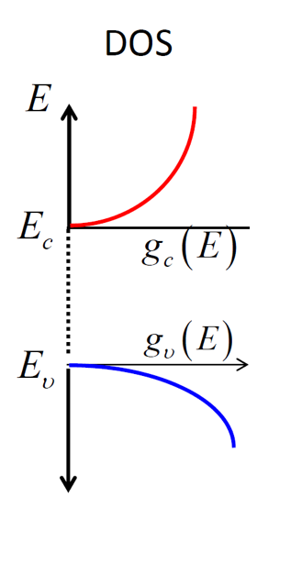


Fermi Statistics: Applications
E
f (E)
Electron concentration in conduction band
$$g_{c}\left(E\right)f(F)$$
E_{F}
Hole concentration in valance band
1 - f(E)
$$g_{v}\left(E\right)[1−f\left(F\right)]$$
1

Slide 19
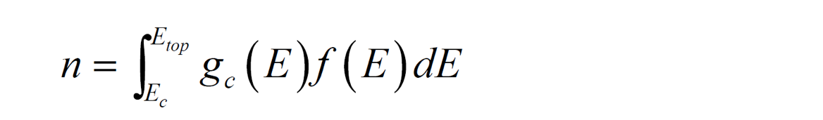
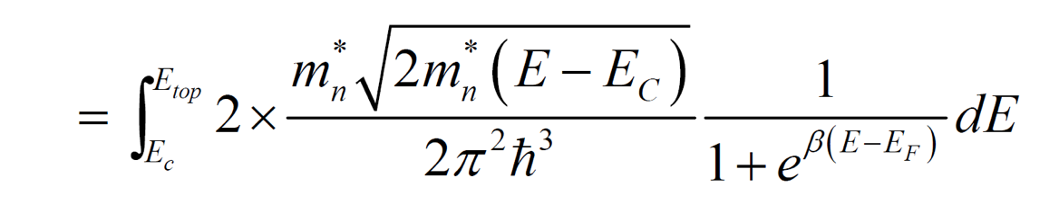
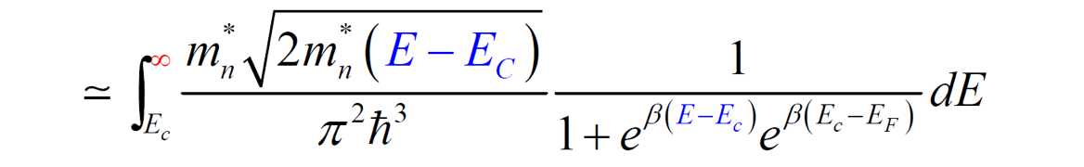
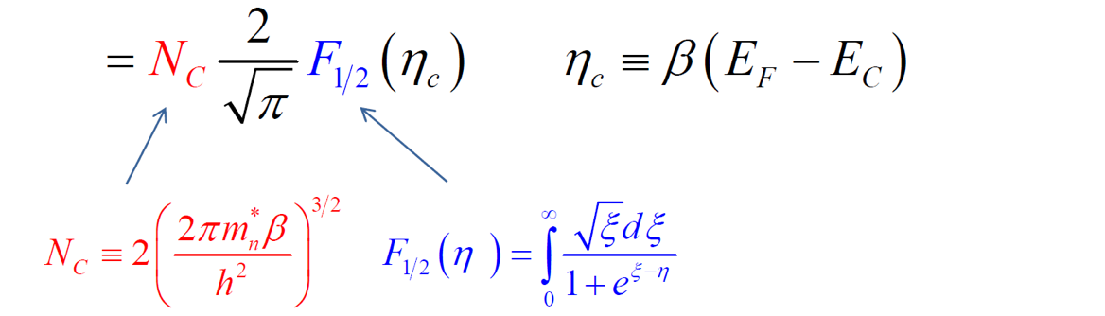
Electron Concentration

Slide 20
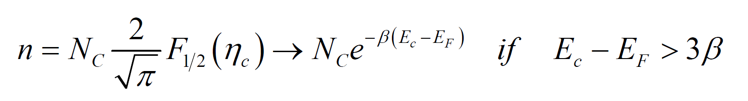


Effective Density of States

Slide 21



What we learnt in this class
What type of semiconductor it is?

